Slide 1
Table management
20201029
Daniel

Slide 2
Agenda
Run time status
Components of Cache GHP Map
Components of H2F Map
Components of F2H Map
EOB and Finish page
H2F F2H mapping
Components of a Group
Components of a Zone
Components of G2F Map
Rebuild H2F Map From Map Block
Multilevel paging concept
Rebuild H2F Map From index array
Read Table update
Write table update
Rebuild SM2246 whole Map
Rebuild SM226x Map

Slide 3
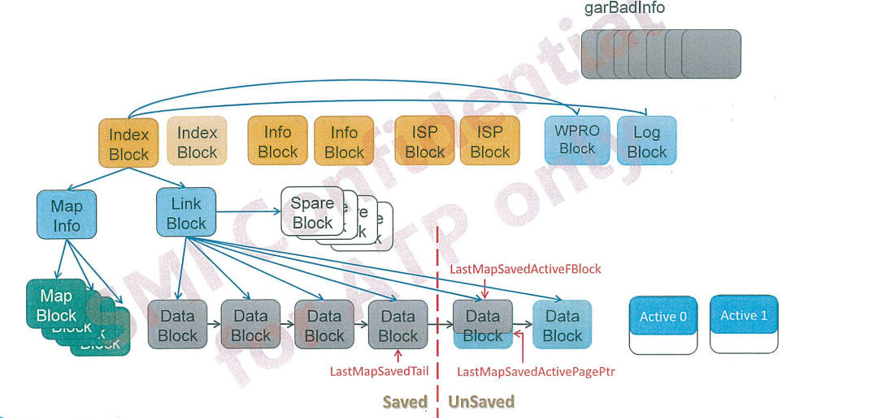
Run time status
Notes:
這是目前FW的總體架構

Slide 4
Components of Cache GHP Map
Each elements is 32-bit
To indicate the GHP on each unit of DRAM Cache
1LBA = 512Byte，4K = 8LBA
Bit 31-0
GHP
4K data
4 Byte

Slide 5
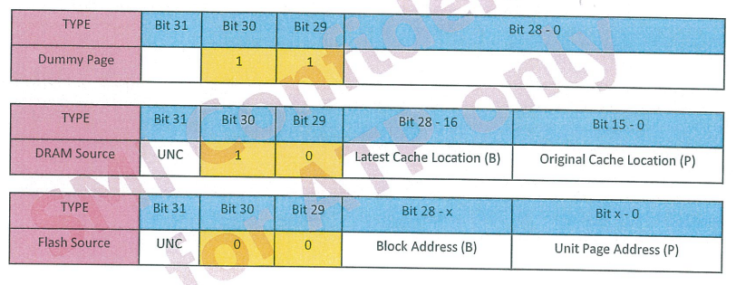
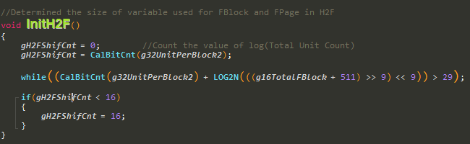
Components of H2F Map
Each element is 32-bit
The size to indicate the unit page address in flash depends on the size of super block
To indicate the current of GHP

Slide 6
Components of F2H Map
Each element is 32-bits
To indicate the GHP on each unit of flash
Bit 31-0
GHP
Block12
g32arF2HMap
0 | 1 | 2 | 3
GHP22 | GHP2 | GHP24 | GHP4
0 | 1 | 2 | 3
22 | 2 | 24 | 4
4 | 5 | 6 | 7
GHP1 | GHP0 | GHP6 | GHP9
4 | 5 | 6 | 7
1 | 0 | 6 | 9

Slide 7
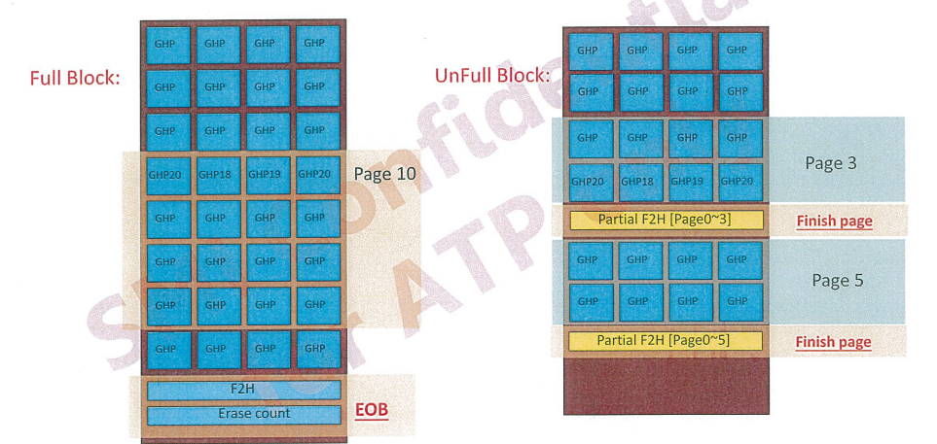
EOB and Finish page

Slide 8
H2F F2H mapping
F2H
g32arF2HMap[0] | 5
g32arF2HMap[1] | 5
g32arF2HMap[2] | 5
…………………..
F2H
garH2FMap[4] | B=12,P=6
garH2FMap[5] | B=12,P=2
garH2FMap[6] | B=12,P=7
garH2FMap[7] | B=12,P=9
CH0
CH1
Block12
Block12
GHP5
GHP5
GHP5
GHP4
GHP4
GHP7
GHP4
GHP7
GHP8
GHP8
GHP8
GHP8
GHP8
GHP8
GHP8
GHP8
CE0
Block12
Block12
GHP8
GHP8
GHP8
GHP8
GHP8
GHP8
GHP8
GHP8
GHP8
GHP8
GHP8
GHP8
GHP8
GHP8
GHP8
GHP8
CE1

Slide 9
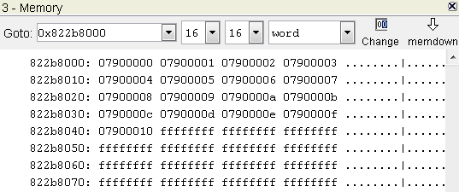
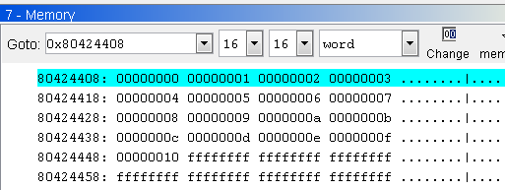
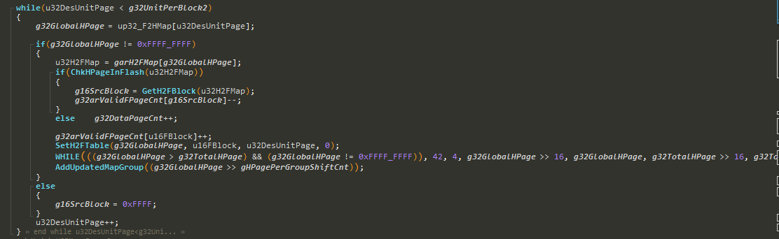
H2F F2H mapping
Function : void UpdateH2FMap_PowerOn(WORD u16FBlock, LWORD *up32_F2HMap)
H2F
F2H

Slide 10
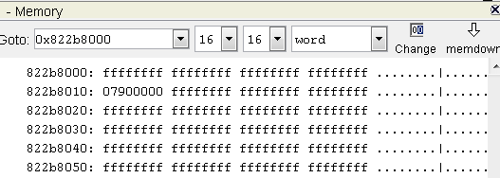
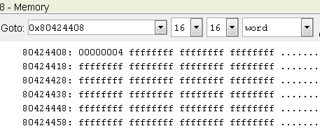
H2F F2H mapping
Write LBA 0x20
g32arF2HMap[0]=4 ←→ garH2FMap[4]
H2F
F2H
Notes:
寫LBA 0x20 2*16=32 32/8=4 →GHP 4

Slide 11
Components of a Group
Each Group contains 512 H2F Map elements
Each H2F Map elements is 32-bits(4 Byte)
Each Group is 2k (512*4-Byte)
Group 0
Group 3
H2F[0]
H2F[1536]
H2F[1]
H2F[1537]
H2F[2]
H2F[1538]
H2F[511]
H2F[2047]

Slide 12
Components of a Zone
Each Zone is equal to a Map Super Block
At most 32 Zones
Total Groups are equally divided into the existing Zone
Zone0
0 | 1 | 2 | 3
G4 | G3 | G4 | G6
0 | 1 | 2 | 3
G14 | G18 | G24 | G27

Slide 13
Components of G2F Map
Each element is 32-bit
To indicate the located 2k-unit of the Group index
Bit 31-0
Located 2k-unit

Slide 14
Components of G2F Map
Write flow : AddUpdatedMapGroup() Will do group update
Zone 0
g32arG2FMap
0 | 1 | 2 | 3
G4 | G3 | G4 | G2
GX
0 | 1 | 2 | 3
5 | 6 | 3 | 7
4 | 5 | 6 | 7
G4 | G0 | G1 | G3
4
4
Valid Map Cnt 5

Slide 15
Rebuild H2F Map From Map Block
Read ZoneX G2F Table
Zone X
H2F
Search Direction
G2F
4 | 7 | 0 | 9 | 12 | 17 | 21 | 16
g16arFreePtrOfLinkBlock

Slide 16
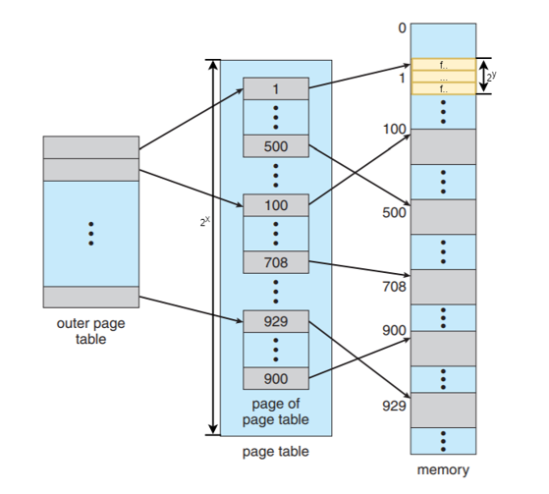
Multilevel paging concept
Notes:
並不是將分頁表縮小，而是將不需要的分頁表先存在Flash之中，縮小分頁表在 RAM 佔有的空間，所以提出多層次的分頁，藉由此作法，不須將整個分頁表全部載入 RAM ，而是載入部分所需的內容

Slide 17
Multilevel paging concept
Not Multilevel paging
(2T/4k)*4Byte = 2G DRAM
(16T/4k)*4Byte = 16G DRAM >> 2G DRAM
Multilevel paging example:
Per T1 (Table 1) use 32K Byte size save a FPage at Flash SLC block
Per T1 Management 4KHPage number be 32K/4(Byte)=8K(0x2000).
Per T1 Management Data size be 4K(Data size)*8K(4KHPage number)=32MB
Per T1 we call per T1 Group
Per T2 (Table 2) use 32K Byte size save a FPage at Flash SLC block.
Per T2 had 8’s T2 chunk, means Per T2 chunk use 4KByte.
Per T2 chunk management 1K T1 Group, Per T1 Group management 32MB,so,Per T2 Group management 8K*32MB= 256GB.

Slide 18
Multilevel paging concept
T4 table
T2 Group 0
T2 Group 1
T2 Group 2
T2 Group 3
T2 Group 4
T2 Group 5
T2 Group 6
T2 Group 7
T1 Group 1 Info
4K HPage 0 Info
4K HPage 1 Info
. . .
4K HPage 8191 Info
4K Hpage 1
LBA 0
LBA 1
LBA 2
LBA 3
LBA 4
LBA 5
LBA 6
LBA 7
T2 Group 2
T2 Chunk 0
T2 Chunk 1
T2 Chunk 2
T2 Chunk 3
T2 Chunk 4
T2 Chunk 5
T2 Chunk 6
T2 Chunk 7
T2 Chunk 2
T1 Group 0 Info
T1 Group 1 Info
. . .
T1 Group 1023 Info
Per T1 group -> 8k*4k = 32M
Per T2 group -> T1 group 8*1k = 8k
Per T2 group management 8k*32M = 256G

Slide 19
Rebuild H2F Map From index array
Increase the table size corresponding to index array expansion
index
Table
Notes:
增加index array擴展所能對應的table大小，由於SSD DRAM並不像SD卡能用的SRAM那麼小所以並不需要像SD卡需要那麼多層

Slide 20
Read Table update
EX : Read G0 and exist
1 先尋找index array是否存在
2 index array G0存在
3 透過index array找到相對應的table位置
4 read data
DRAM
0
7
0
G0
index
0
G0
G2F
4 | 7 | 0 | 9 | 12 | 17 | 21 | 16
7

Slide 21
Read Table update
EX : Read G3 and not found
1 先尋找index array發現G3不在index array上
2 Read G2F Table上的G3到DRAM上
3 將位置填回index array
4 read data
0
DRAM
7
0
G0
G3
index
0
G0
3
G3
G2F
4 | 7 | 0 | 9 | 12 | 17 | 21 | 16
7

Slide 22
Write table update
EX : Write G0 and exist
1 先尋找index array是否存在
2 index array G0存在
3 透過index array找到相對應的table位置
4 做G0資料的更新
0
DRAM
7
0
G0
index
0
G0
G2F
7
4 | 7 | 0 | 9 | 12 | 17 | 21 | 16

Slide 23
Write table update
EX : Write G3 and not found
1 先尋找index array發現G3不在index array上
2 Read G2F Table上的G3到DRAM上
3 做G3資料的更新
4 將位置填到index array
0
DRAM
7
0
G0
G3
index
0
G0
3
G3
G2F
7
4 | 7 | 0 | 9 | 12 | 17 | 21 | 16

Slide 24
Rebuild H2F Map From index array (Group index swap)
index
Group
G0
0
1
2
3
4
5
G1
Table
DRAM Size 512M
16T/2k=8M個group
8M*4byte=32M
Stage1 先照順序上group
驗證
0
7
G2
G3
G0 | G1 | G2 | G3 | G4 | G5
0
G4
G5
G6
…….
G249
G250
7
G251
G252
G253
G254

Slide 25
Rebuild H2F Map From index array (Group index swap)
index
Group
G0
0
5
42
6
63
23
G1
Table
DRAM Size 512M
16T/2k=8M個group
8M*4byte=32M
Stage2 index非順序填入
0
7
G2
G3
G0 |  |  |  |  | G1 | G5
 |  |  |  |  |  |  | G254
 |  | G2
 |  |  |  |  |  |  | G253
0
G4
G5
G6
…….
G249
G250
7
G251
G252
G253
G254

Slide 26
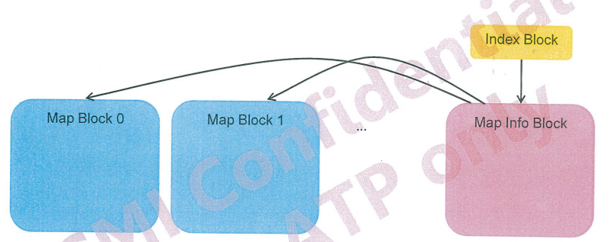
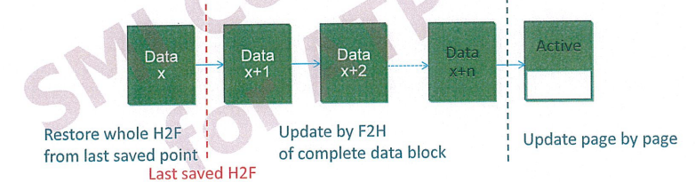
Rebuild SM2246 whole Map
Find the map information to find the information
Step1:Restore whole H2F Map from last save point
Step2:Update H2F by F2H within EOB of complete data block
Step3:Update H2F by finish page or metadata on each page of active block
Notes:
MapInfo會存一些必要資訊

Slide 27
Rebuild SM2246 whole Map
Build all zone -> Build 16’s unsaved block EOB -> Build Active Block
Unsaved
Zone
Unsaved
Active
Active

Slide 28
Rebuild SM226x Map
Partial rebuild map
First find active block -> unsaved block -> Map block
Active Block
DRAM
Map Block
Finish Page
G2F
Unsaved Block
EOB
Notes:
先從可能是最新的table build起

Slide 29
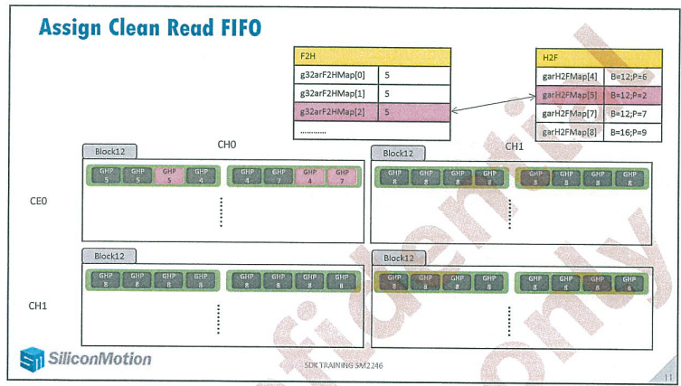
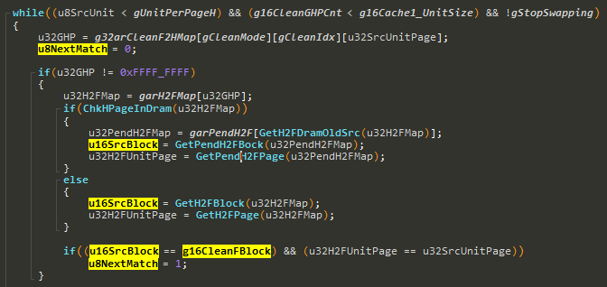
Data GC flow(SM2246)
Read clean block F2H <---->H2F是否對應，對應代表valid

Slide 30
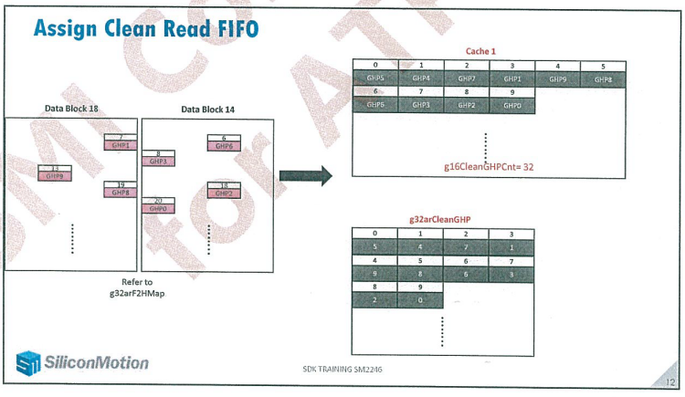
Data GC flow(SM2246)

Slide 31
Write Flow
H2F
在write的過程中Group會一直被替換
Gx
Gx
G0 | 0
G1 | 1
G2 | 2
G3 | 3
G4 | 4
Host
Gx
Write
Gx
F2H
被swap過的Group湊齊page寫回Map block
0 | 1 | 2 | 3 | 4 | 5 |  |  | 14 | 15
G | G | G | G | G | G | G | G | G | G
Map block
G2F
Unsaved block>=16寫回map block
Data block
Data block
….
Data block
Unsaved block
Act0
Act1
G2F
save
unsaved

Slide 32
Read Flow
DRAM Space
G0
G1
G2
G3
G0 | 0
G1 | 1
G2 | 2
G3 | 3
G4 | X
Host
Read
Gx
Gx
Gx
search group array判斷是否已經存在
if不存在search active block->unsaved block->map block
找最新的H2F
active block
unsaved block
Map block
Finish page
G2F
EOB

Slide 33
Data GC flow
H2F
Gx
Gx
Valid page count<X
G0 | 0->4
G1 | 1->9
G2 | 2->6
G3 | 3->8
G4 | 4->1
Source block
Source block
Source block
Gx
G3
G8
EOB
EOB
EOB
Read EOB update F2H table
F2H
Record old group
G3
Map block
0 | 1 | 2 | 3 | 4 | 5 |  |  | 14 | 15
G3 | G | G | G | G | G | G | G | G | G
Read G2F更新H2F
Map
G2F
Destination block
Gx
Gx
Gx
Gx
湊齊回存
GC data
G2F

Slide 34
WL flow
Trigger point : gWearBlockCnt > 0
Find erase count < threshold block
Gx
Gx
Destination block
Gx
Gx
Source block
Source block
Source block
Gx
Gx
EOB
EOB
EOB
Gx
Gx
F2H
Read F2H table
EOB
Write to destination flash
Active block
Update H2F table
Unsaved block
Map block

